Slide 1
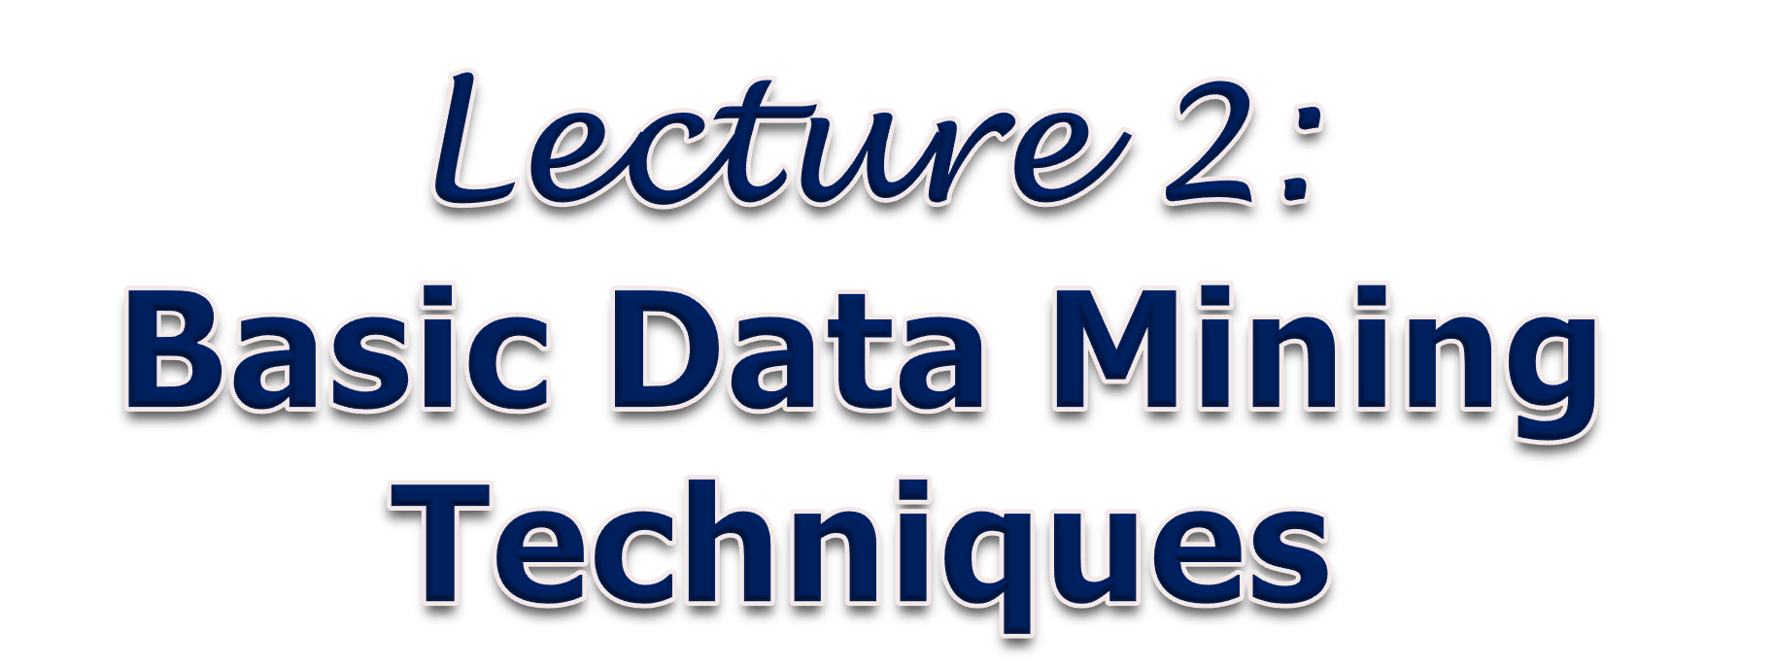

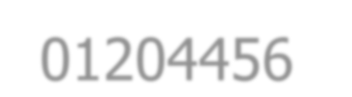
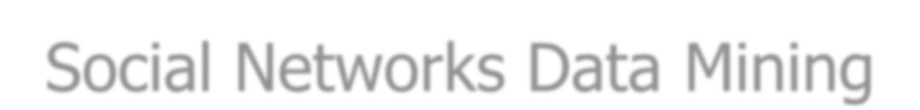
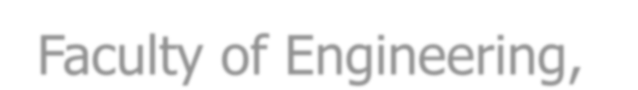
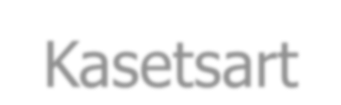
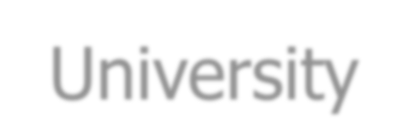
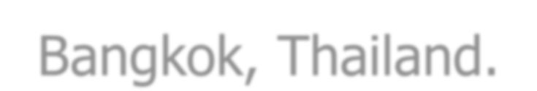


01204456 Social Networks Data Mining
Department of Computer Engineering Faculty of Engineering, Kasetsart University Bangkok, Thailand.

Slide 2

Outline
Association Rule Discovery
Classification
Clustering

Slide 3

Motivation
Lots of data is being collected (example for social networks):
Online purchase transactions
Web access/usage logs
Twitter posts
Facebook users’ behaviors and activities
– …
There is often information hidden in such data that is not readily evident.
Human analysts take very much time to discover useful information.

Slide 4


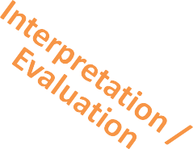


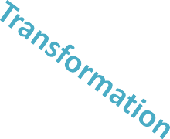
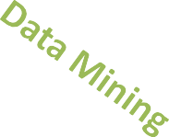
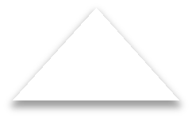


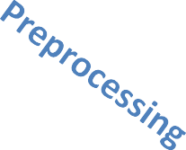










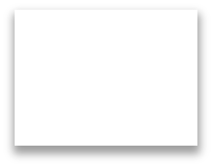








What is Data Mining?
Many definitions:
Non-trivial extraction of implicit, previously unknown and useful information from data
Exploration & analysis, by automatic or semi-automatic means, of large quantities of data in order to discover meaningful patterns
patterns
knowledge
… … …
… … …
preprocessed data
transformed data
target data
data

Slide 5

Data Mining
Process of (semi-)automatically analyzing large databases to find patterns that are:
valid – hold on data with some certainty
novel – non-obvious to the system
useful – should be possible to act on the item
understandable – should be able to interpret the pattern

Slide 6

Applications
Banking loan/credit card approval:
Predict good customers based on old customers
Customer relationship management:
Identify those who are likely to leave for a competitor
Targeted marketing:
Identify likely responders to promotions
Fraud detection in OSNs:
Identify spammers
Web site/store design and promotion:
Find affinity of visitor to pages and modify layout
• …

Slide 7
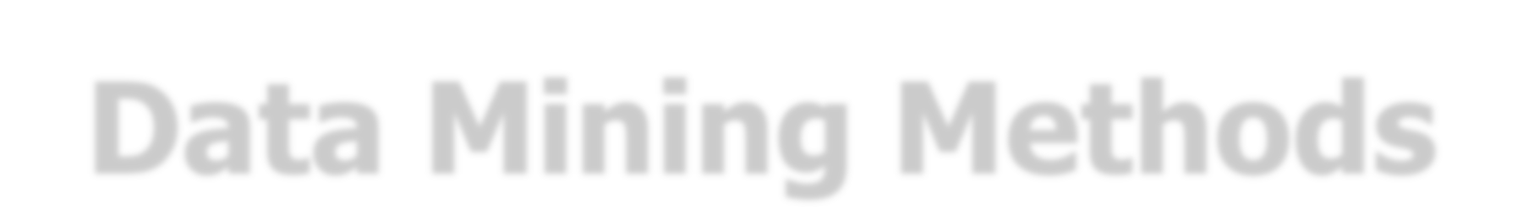
Data Mining Methods
Prediction methods
Use some variables to predict unknown or future values of other variables
e.g., classification, regression
Description methods
Find human-interpretable patterns that describe the data
e.g., clustering, pattern detection

Slide 8


Predictive Modeling
Predict one variable Y given a set of other variables X
Here X could be a p-dimensional vector
Classification: Y is categorical
Regression: Y is real-valued
Users’ characteristics and behaviors
Spammer ?
Yes or No
Many algorithms modeling in statistics and machine learning
Often the emphasis is on predictive accuracy, less emphasis on understanding the model

Slide 9
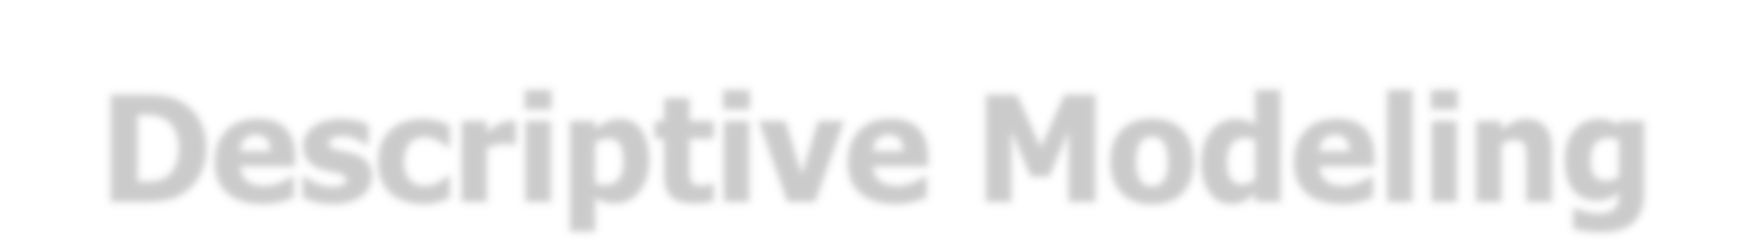

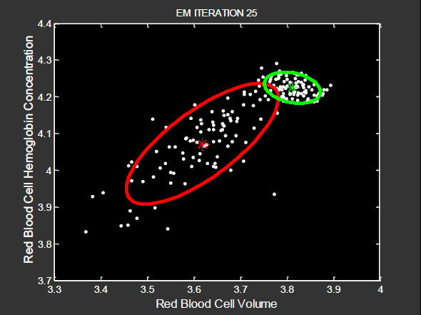
Descriptive Modeling
Find an interpretable summarization of the data:
Detect interesting patterns
Summarize statistics
Visualization
Cluster analysis: find natural groups in the data

Slide 10

Data Mining Tasks
Association rules discovery
Sequential pattern discovery
Classification
Regression
Clustering
Anomaly Detection
• …
10

Slide 11
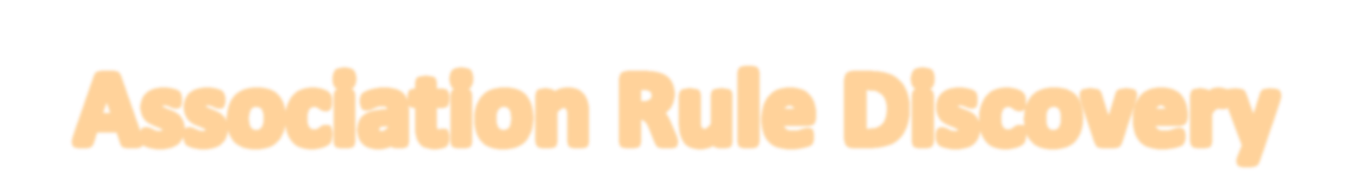
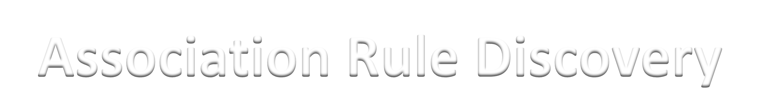



Slide 12

Association Rule Discovery
Proposed by Agrawal et al. in 1993
An important model studied extensively by the database and data mining community
Initially, used for the market basket analysis
Assume all data are categorical

Slide 13
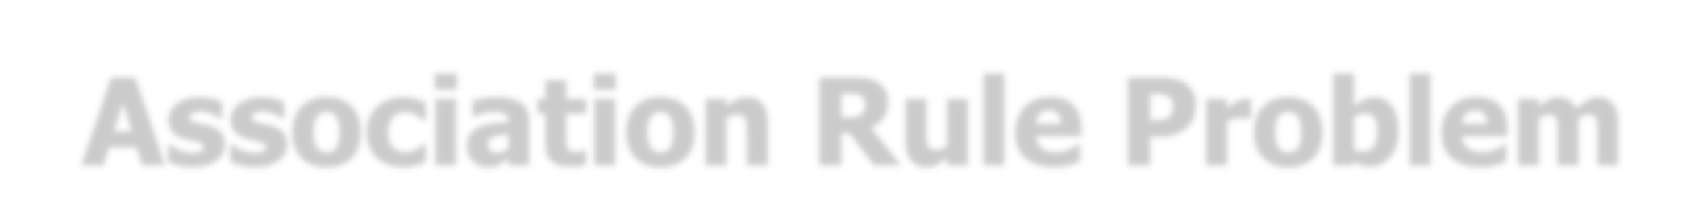
Association Rule Problem
Given a database of transactions:
Transactions | Items
t₁ | bread, jelly, butter
t₂ | bread, butter
t₃ | bread, milk, butter
t₄ | beer, bread
t₅ | beer, milk
Find all the association rules:
X ⇒ Y | Sup. | Conf.
bread ⇒ butter | 60% | 75%
butter ⇒ bread | 60% | 100%
beer ⇒ bread | 20% | 50%
butter ⇒ jelly | 20% | 33.3%
jelly ⇒ butter | 20% | 100%
jelly ⇒ milk | 0% | 0%

Slide 14

Definition
I = {i₁, i₂, …, i_{m}}: a set of m possible items
D = {T₁, T₂, …, T_{n}}: a transaction database containing a set of n transactions
– T_{i}: a set of items such that T_{i} ⊆ I
An association rule is an implication of the form X ⇒ Y, where X, Y ⊂ I and X ∩ Y = ∅

Slide 15

Examples of Transaction Data
Supermarket – market basket transactions
T₁: | {bread, cheese, milk}
T₂: | {apple, eggs, salt, yogurt}
…
T_{n}: | {biscuit, eggs, milk}
{bread} ⇒ {eggs, milk}
Documents – a bag of keywords
Doc₁: | {student, teach, school}
Doc₂: | {student, school, computer}
…
Doc_{n}: | {basketball, team, city, game}
{computer} ⇒ {school}

Slide 16
Examples of Transaction Data
Friendship – a set of people who are friends
ann: | {boy, jane, tom}
boy: | {ann, jane}
…
tom: | {ann, lisa, jame}
{ann, boy} ⇒ {tom}

Slide 17
Definition
itemset: a set of items
e.g., X = {bread, cereal, milk} is an itemset.
k-itemset: an itemset with k items
e.g., {bread, cereal, milk} is a 3-itemset.

Slide 18
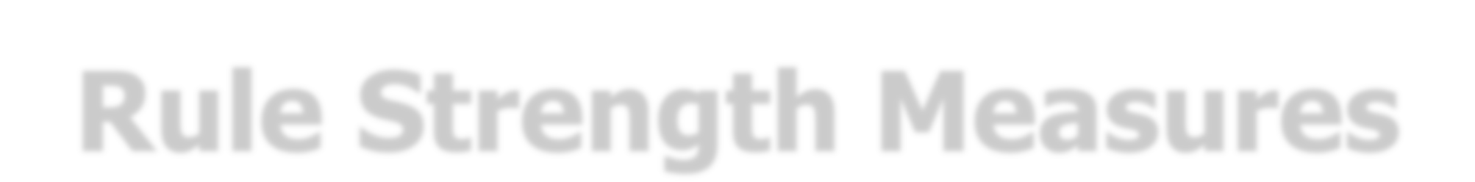
Rule Strength Measures
Support value
The support of an itemset X is the percentage of transactions in the transaction database D that contain X.
The support of a rule X ⇒ Y is the support of the items set X ∪ Y
in D.
sup(X ⇒ Y) = P(X ∪ Y)
Confidence value
– The confidence of a rule X ⇒ Y is the ratio of the number of transactions containing X ∪ Y to the number of transactions containing X in D.
conf(X ⇒ Y) = P(Y|X)

Slide 19

Example
Given a database of transactions:
Transactions | Items
t₁ | bread, jelly, butter
t₂ | bread, butter
t₃ | bread, milk, butter
t₄ | beer, bread
t₅ | beer, milk
The example of association rules:
X ⇒ Y | Sup. | Conf.
bread ⇒ butter | 60% | 75%
butter ⇒ bread | 60% | 100%
beer ⇒ bread | 20% | 50%
butter ⇒ jelly | 20% | 33.3%
jelly ⇒ butter | 20% | 100%
jelly ⇒ milk | 0% | 0%

Slide 20
Association Rule Problem
Given
a set I of all items
a database D of transactions
minimum support threshold min_sup
minimum confidence threshold min_conf
Find
all association rules X ⇒ Y with min_sup and min_conf
20

Slide 21

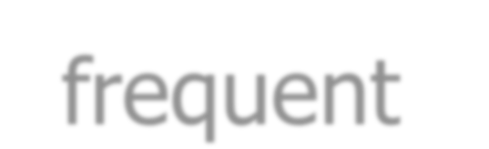
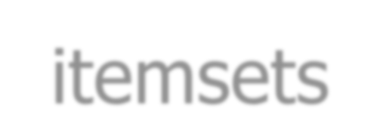
Problem Decomposition
Find all sets of items that have a minimum support, called frequent itemsets
Use the frequent itemsets to generate the desired rules with a minimum confidence

Slide 22

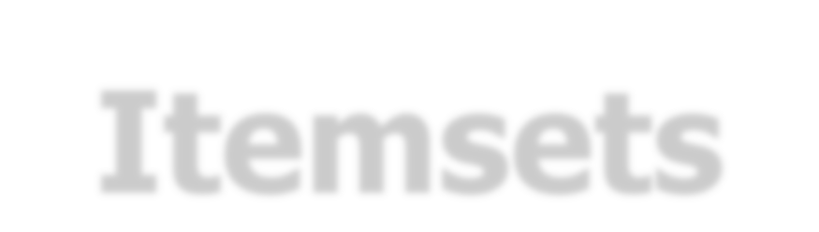
Finding Frequent Itemsets
Trans. ID | Items
1 | shoes, shirt, jacket
2 | shoes, jacket
3 | shoes, jeans
4 | shirt
Suppose the min_sup = 50%,
{jacket,shoes} is the only 2-itemset that satisfies.
{ }
{jacket}
{jean}
{shirt}
{shoes}
{jacket,jean} {jacket,shirt}
{jacket,shoes}
{jean,shirt} {jean,shoes} {shirt,shoes}
{jacket,jean,shirt}
{jacket,jean,shoes}
{jacket,shirt,shoes}
{jean,shirt,shoes}
lattice
{jacket,jean,shirt,shoes}

Slide 23

Generating Association Rules
Trans. ID | Items
1 | shoes, shirt, jacket
2 | shoes, jacket
3 | shoes, jeans
4 | shirt
We have the frequent itemsets:
{jacket}, {shirt}, {shoes}, and
{jacket,shoes}
Suppose the min_conf = 50%,
two rules are generated from this 2-itemset {jacket,shoes}:
{jacket} ⇒ {shoes} with sup = 50% and conf = 100%
{shoes} ⇒ {jacket} with sup = 50% and conf = 66.67%

Slide 24
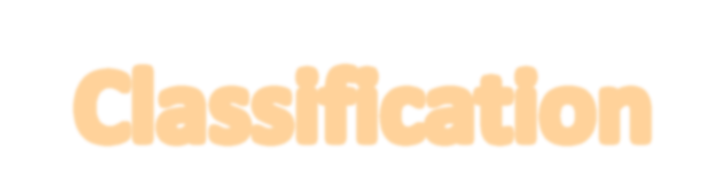



Slide 25
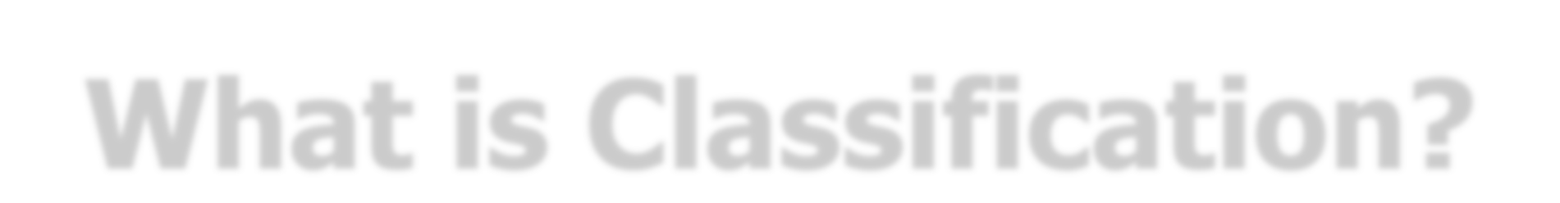
What is Classification?
A process to predict group membership for data instance
Given: a training dataset D and a fixed set of classes C
Each instance d∈D has been labeled with a class c_{j}∈C
Goal:
Create a classifier γ maps any unknown instance to the most preferred class
γ: X → C

Slide 26

An Example
Given
Day | Outlook | Temperature | Humidity | Wind | PlayTennis
1 | Sunny | Hot | High | Weak | No
2 | Sunny | Hot | High | Strong | No
3 | Overcast | Hot | High | Weak | Yes
4 | Rain | Mild | High | Weak | Yes
5 | Rain | Cool | Normal | Weak | Yes
6 | Rain | Cool | Normal | Strong | No
7 | Overcast | Cool | Normal | Strong | Yes
8 | Sunny | Mild | High | Weak | No
9 | Sunny | Cool | Normal | Weak | Yes
10 | Rain | Mild | Normal | Weak | Yes
11 | Sunny | Mild | Normal | Strong | Yes
12 | Overcast | Mild | High | Strong | Yes
13 | Overcast | Hot | Normal | Weak | Yes
14 | Rain | Mild | High | Strong | No
Predict the value of PlayTennis for
<Outlook = sunny, Temperature = cool, Humidity = high, Wind = strong>

Slide 27

Different Type of Classifiers
Linear discriminant analysis (LDA)
Quadratic discriminant analysis (QDA)
Density estimation methods
Nearest neighbor methods
Logistic regression
Neural networks
Fuzzy set theory
Decision Tree
• …

Slide 28
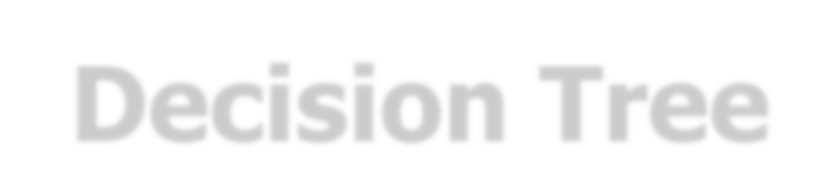

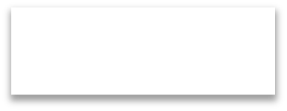
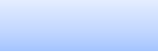

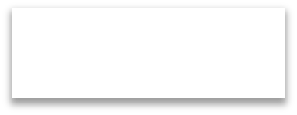
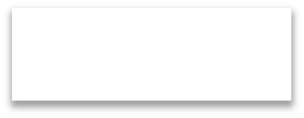
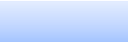
Decision Tree
A classifier that encodes dataset D in form of a tree:
Each internal node tests an attribute
Each branch corresponds to an attribute value
Each leaf node assigns a class
Example:
– Decision tree for PlayTennis
Outlook
Sunny
Overcast
Rain
Humidity
Yes
Wind
High
Normal
Strong
Weak
No
Yes
No
Yes

Slide 29



Top-Down Tree Construction
BuildTree (Node t, Training dataset D, Spilt Method M)
Apply M to D to find splitting criterion
if (t is not a leaf node)
Create children nodes of t
Partition D into children partitions
Recurse on each partition
endif

Slide 30

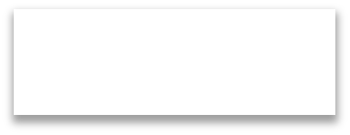

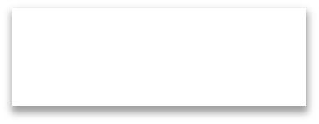

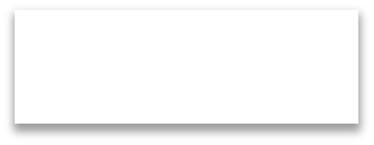
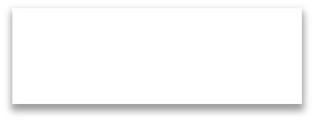
Splitting Criterion
Which attribute is the best classifier?
D: [9+,5-]
Outlook
D: [9+,5-]
Sunny
Overcast
Rain
Temp.
Hot
Mild
Cool
[2+,3-]
[4+,0-]
[3+,2-]
[2+,2-]
[4+,2-]
[3+,1-]
D: [9+,5-]
Humidity
D: [9+,5-]
Wind
High
[3+,4-]
Normal
[6+,1-]
Strong
[6+,2-]
Weak
[3+,3-]
30

Slide 31


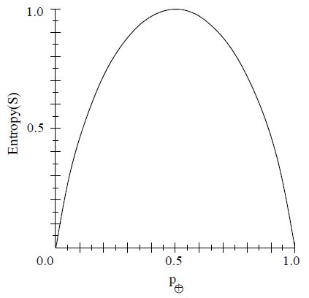
Entropy
Let S be a sample of training examples
p₊ is the proportion of positive examples in S
p– is the proportion of negative examples in S
Entropy measures the impurity of S
Information theory:
Entropy(S) = expected number of bits needed to encode + or –
for a randomly drawn member of S
Entropy(S) ≡ –p₊log₂p₊ –p–log₂p–

Slide 32
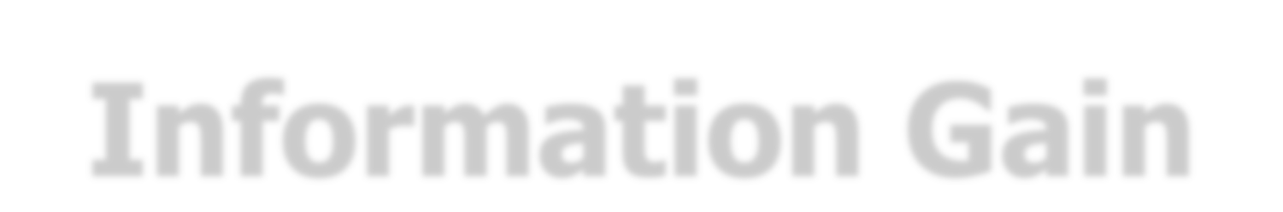
Information Gain
Information gain:
– expected reduction in entropy due to sorting on A
Gain(S,A) ≡ Entropy(S) – Σ_{v∈Values(A)} ^{|Sv|} Entropy(S_{v})
|S|

Slide 33







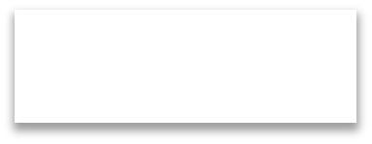







Tree Construction
Entropy(S) ≡ –p₊log₂p₊ –p–log₂p–
Entropy = – (9/14)log₂(9/14)
– (5/14)log₂(5/14)
= 0.940
Gain(S,A) ≡ Entropy(S) – Σ_{v∈Values(A)} ^{|Sv|} Entropy(S_{v})
|S|
D: [9+,5-]
Entropy = – (3/5)log₂(3/5)
Outlook
– (2/5)log (2/5)
Sunny
2
Overcast
Rain
= 0.971
[2+,3-]
[4+,0-] [3+,2-]
Entropy = – (4/4)log₂(4/4)
– (0/4)log₂(0/4)
= 0
Entropy = – (2/5)log₂(2/5)
– (3/5)log₂(3/5)
= 0.971
no negative example
Gain(S,Outlook) = 0.940 – (5/14)(0.971) – (4/14)(0) – (5/14)(0.971)
= 0.246

Slide 34
Tree Construction
Gain(S,Outlook) = 0.246✓
D: [9+,5-]
Gain(S,Temp.) = 0.029
D: [9+,5-]
Outlook
Sunny
Overcast
Rain
Temp.
Hot
Mild
Cool
[2+,3-]
[4+,0-]
[3+,2-]
[2+,2-]
[4+,2-]
[3+,1-]
D: [9+,5-]
Humidity
D: [9+,5-]
Wind
High
[3+,4-]
Normal
[6+,1-]
Strong
[6+,2-]
Weak
[3+,3-]
Gain(S,Humidity) = 0.151
Gain(S,Wind) = 0.048

Slide 35






Tree Construction
D: [9+,5-]
Outlook
Sunny
Overcast
Rain
[2+,3-]
[3+,2-]
?
Yes
[4+,0-]
?
Which attribute is the best here?
Outlook
Sunny
Overcast
Rain
Humidity
Yes
Wind
High
Normal
Strong
Weak
No Yes No
<Outlook = sunny, Temperature = cool, Humidity = high, Wind = strong> ⇒ No
Yes

Slide 36




Slide 37

What is Clustering?
A process of grouping a set of objects into clusters of similar objects
Given: dataset D and similarity/distance metric
Find (objective):
Partitioning of data
Groups (classes) of similar objects
High intra-class similarity
Objects within a cluster should be similar.
Low inter-class similarity
Objects from different clusters should be dissimilar.

Slide 38
















































Dataset with Clear Cluster Structure

Slide 39









What is Similarity?
“The quality or state of being similar; resemblance; likeness.”
Webster’s dictionary

Slide 40






Minkowski Distance (L_{p} Norm)
Consider two objects, x = (x₁,…,x_{d}) and y = (y₁,…,y_{d})
p
d(x,y) = √|x₁ – y₁|^{p} + |x₂ – y₂|^{p} + … + |x_{d} – y_{d}|^{p}
Special cases:
p = 1: Manhattan distance
d(x,y) = |x₁ – y₁| + |x₂ – y₂| + … + |x_{d} – y_{d}|
p = 2: Euclidean distance
d(x,y) = √|x₁ – y₁|² + |x₂ – y₂|² + … + |x_{d} – y_{d}|²
40

Slide 41

Classification vs. Clustering
Classification
Supervised learning
Human-defined classes as input to the algorithm
Clustering
Unsupervised learning
Inferred classes from the data without human input
However, there are many ways of influencing the outcome of clustering
e.g., number of clusters, similarity measure, representation of objects, …

Slide 42
Flat vs. Hierarchical Clustering
Flat clustering
Usually start with a random (partial) partitioning of objects into groups
Refine iteratively
e.g., K-means algorithm
Hierarchical clustering
Create a hierarchy
Top-down, divisive
Bottom-up, agglomerative

Slide 43

Hard vs. Soft Clustering
Hard clustering
Each object belongs to exactly one cluster
More common and easier to do
e.g., flat and hierarchical clustering
Soft clustering
An object can belong to more than one cluster
Make more sense for applications like creating browsable hierarchies
e.g., latent semantic indexing
“sneakers” can be put in two clusters: sports apparel and shoes

Slide 44











K-means Algorithm

Slide 45


K -means
Perhaps, the best known clustering algorithm
Simple but work well in many cases
Use as default/baseline clustering
Represent objects in vector space

Slide 46

K -means
Each cluster in K-means is defined by a centroid.
Objective/partitioning criterion: minimize the average squared difference (Euclidean distance) from centroids
Recall definition of centroid:
μ→(ω) = ¹ Σ→
_{x}→
|ω |
x ∈ω
where, ω denotes a cluster.

Slide 47

K -means Algorithm
Randomly select K centroids
Assign cases to the closest centroid
Compute the K new centroids
Repeat steps (2) and (3) until convergence

Slide 48






























K -means Example
Let K = 2
Randomly select the initial centroids
Assign objs to the closest centroid
Recompute a new centroid of the cluster

Slide 49

Optimality of K -means
Convergence ≠ optimality
Convergence does not mean that it will converge to the optimal clustering!
– Great weakness of K-means
If we start with a bad set of seeds, the clustering can be horrible.

Slide 50
Exercise: Suboptimal Clustering
3
d₁ d₂
d₃
2
1
d₄ d₅ d₆
0
0 1 2 3 4
What is the optimal clustering for K = 2?
For seeds d₂ and d₅, K-means converges to {{d₁,d₂,d₃},{d₄,d₅,d₆}}.
For seeds d₂ and d₃, K-means converges to {{d₁,d₂,d₄,d₅},{d₃,d₆}}.
50

Slide 51






K -means with Different Random Seeds
source: http://shabal.in/visuals.html

Slide 52


Initialization of K -means
Random seed selection is one of many ways K-means can be initialized.
Random seed selection is not very robust.
It’s easy to get a suboptimal clustering.
Better ways of computing initial centroids:
Select seeds using some heuristics
e.g., exclude outliers from the seed set
Try out multiple starting points, and then choose the clustering with lowest cost

Slide 53



Slide 54











































Hierarchical Clustering
1
2
5
3
4
6
5
7 8
6
10
9
11
11
3 4 1 2
9 10
7 8
Goal: automatically create a hierarchical clustering
2 approaches
top-download: divisive clustering
bottom-up: hierarchical agglomerative clustering (HAC)

Slide 55





















Divisive Clustering
A top-down approach
Start with all objects in one big cluster
Then recursively split clusters using a flat clustering algorithm
Eventually each node forms a cluster on its own
➔ Bisecting K-means
1
2
5
3
4
6
7 8
10
9
11

Slide 56













Hierarchical Agglomerative Clustering
HAC creates a hierarchy in the form of a binary tree.
A bottom-up approach
Start with each object in a separate cluster
Then repeatedly merge two clusters that are most similar
Until there is only one cluster.

Slide 57


